Slide 1
IAN

Slide 2
KENT

Slide 3
Tools
Visual Studio 2012
Subversion (SVN)
Tortoise
Anhk

Slide 4
C#

Slide 5
Version 4.5
GENERICS
LINQ
Partial Classes (Allow code generation)

Slide 6
KENT

Slide 7
ADO
All .NET database queries pass through this layer
Burton Code Generation Tool

Slide 8
mvc
Model
Strongly Typed Objects
Controllers
Logic
View Model
View
Razor Engine
HTML Helpers
Routing

Slide 9
App Start
Bundling
Optimization
Dependency Injection
Ninject
Allows to use Interfaces

Slide 10
Testable Framework
Separation of Concerns
Allows for unit testing
Some integration testing

Slide 11
Test Harnesses
MS Test
NUNIT
Qunit (No longer using)

Slide 12
Dependency Injection and MVC
Ninject allows
Constructor Injection
Resolution of Interfaces
Good for testing
Good for long term use

Slide 13
KENT

Slide 14
tED

Slide 15
Html 5/ css 3

Slide 16
Bootstrap and Kendo UI CSS

Slide 17
Burton

Slide 18
Javascript -JqUERY

Slide 19
Kendo ui

Slide 20
Bootstrap

Slide 21
mOMENT
Does time manipulations

Slide 22
jwerty
Does keyboard shortcuts

Slide 23
Entity Framework (EF)

Slide 24

Object Relational Mapper (ORM)

Slide 25

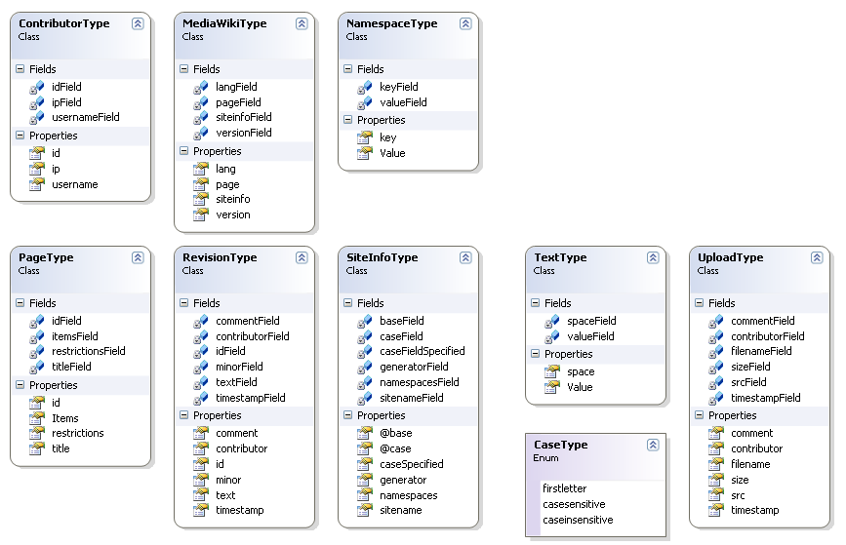
Turns Tables and Views into Classes

Slide 26


Database Repository Pattern

Slide 27
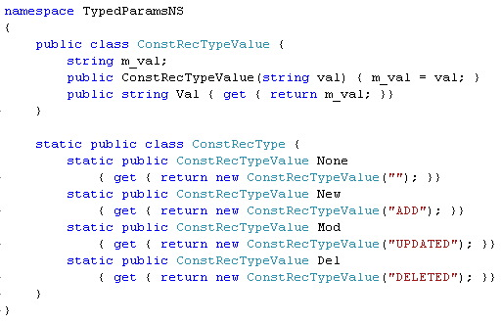
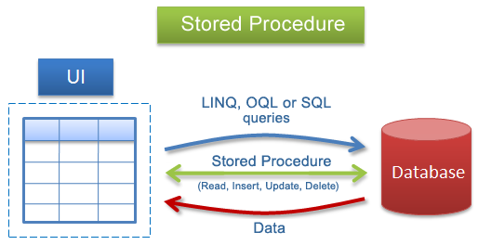
Turns Procedures into Functions

Slide 28
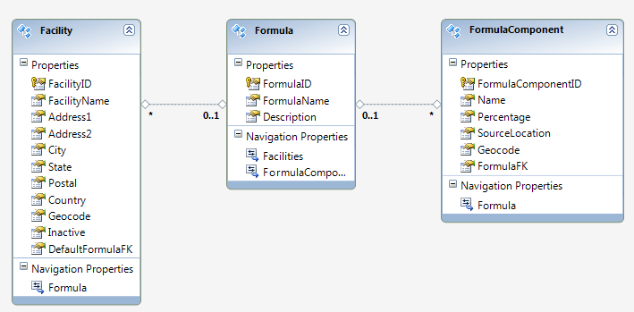
Links classes via keys => Graphs

Slide 29
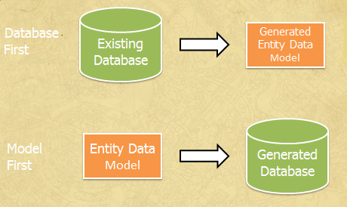
Two styles
We used this

Slide 30

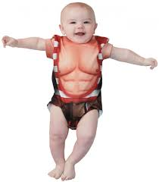
Advantages
Easily create strongly typed objects
Easily map stored procedures
Allow Data Repository Pattern

Slide 31

Disadvantages
Does not handle multiple record sets
Does not handle different record sets depending on parameters
Can be used incorrectly and become unscalable

Slide 32

Why we stopped using it
Believed it was causing slow performance
This wasn’t the ORM but the implementation of Iidentity
The actual speed of the items was not an issue

Slide 33
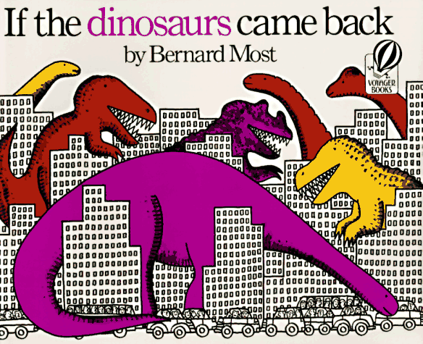
Why It came back
It was a quick way to make stored procs to prove concept
Was only used as a temporary fix
Got pulled out without replacement causing loss of functionality
Will be replaced by Insight

Slide 34
Robert
Insight

Slide 35
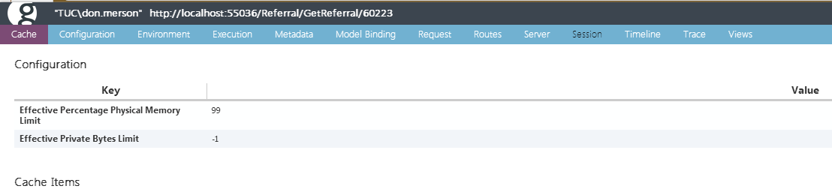
Glimpse

Slide 36
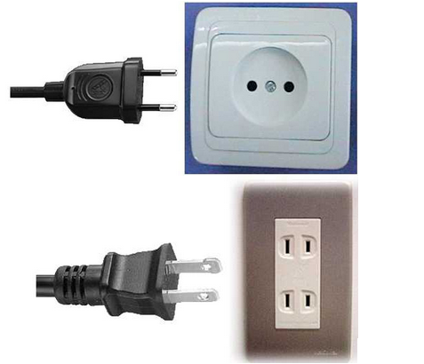

What is it?
Plug-in
Learn more about runtime environment

Slide 37
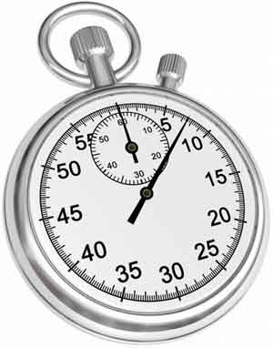
Why did we get it?
Check out our load times

Slide 38
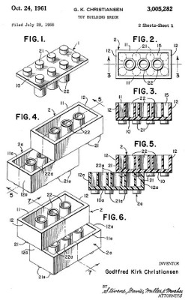
Extensible

Slide 39
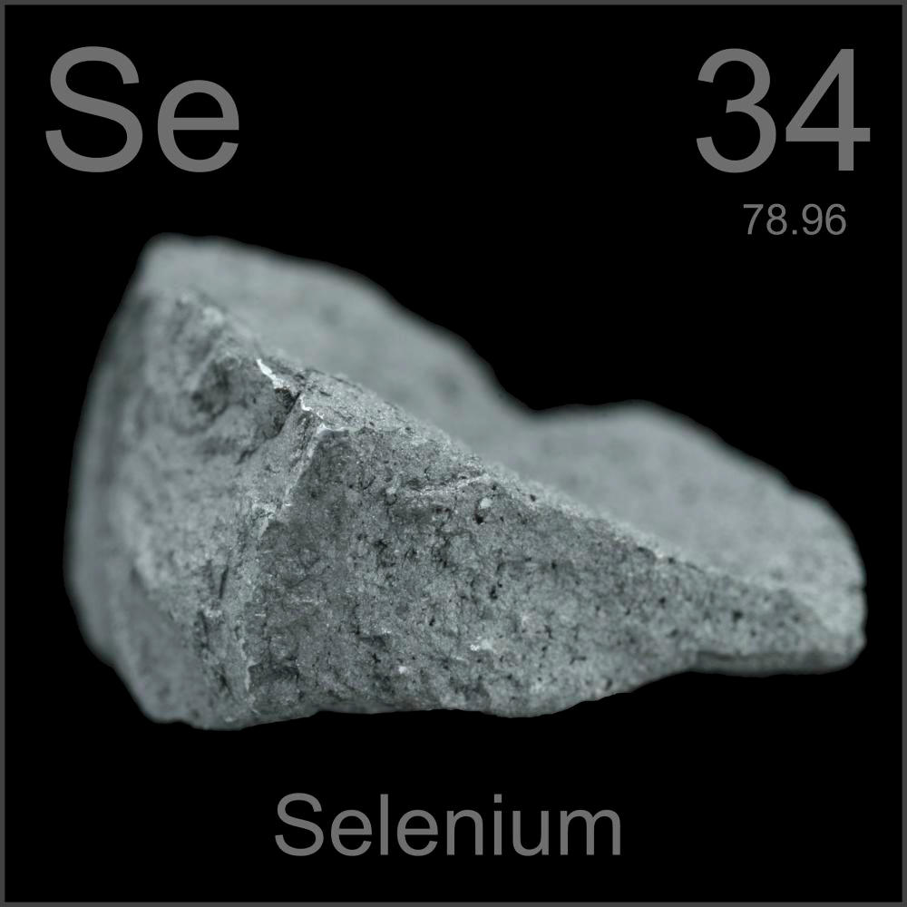
SELENIUM
It is a way to test the interface of a web application
We are using it for regression testing

Slide 40
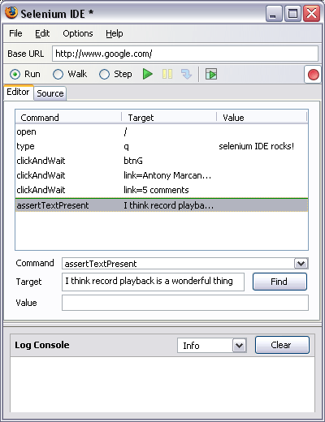
Components
IDE that is a Firefox plugin
Allows user to record their actions and play them back
You can then save as a HTML page to play back later
Can incorporate into suites of tests
Can also save as an NUNIT Test

Slide 41

What we are doing Now
Greg is creating basic tests to verify functionality
QA has recorded some of their tests (Not all at this time)

Slide 42

Our long range plan
Greg will eventually catch up to development
We will have him create a unit test to verify each claimed bit of functionality
Greg will convert all of QA’s recordings into tests
We will try to steal the best ideas from HealthTrio
We will convert QA’s test into a format to allow QA more usable functionality
Create 1000 records in interface to test pricing
We will create a Domain language to allow QA to create tests on the fly
GoTo.Referral(6022)
Enter.Reason(ReasonType.Approve)

